Slide 1
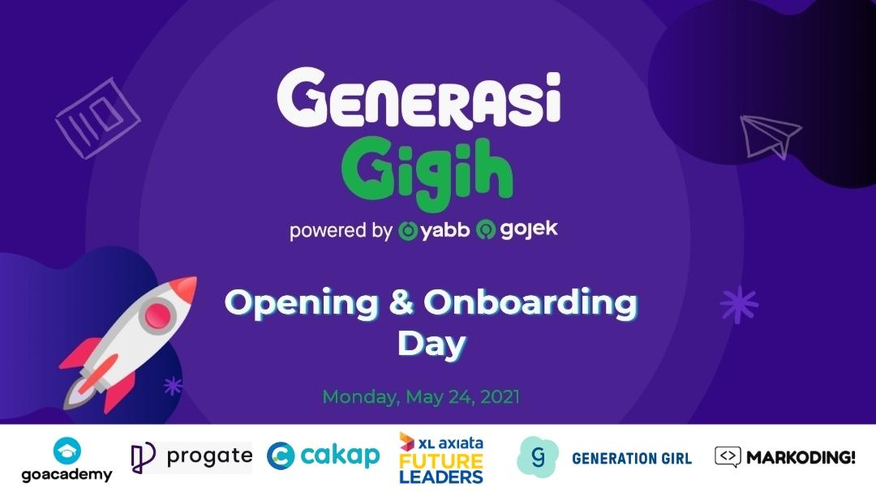
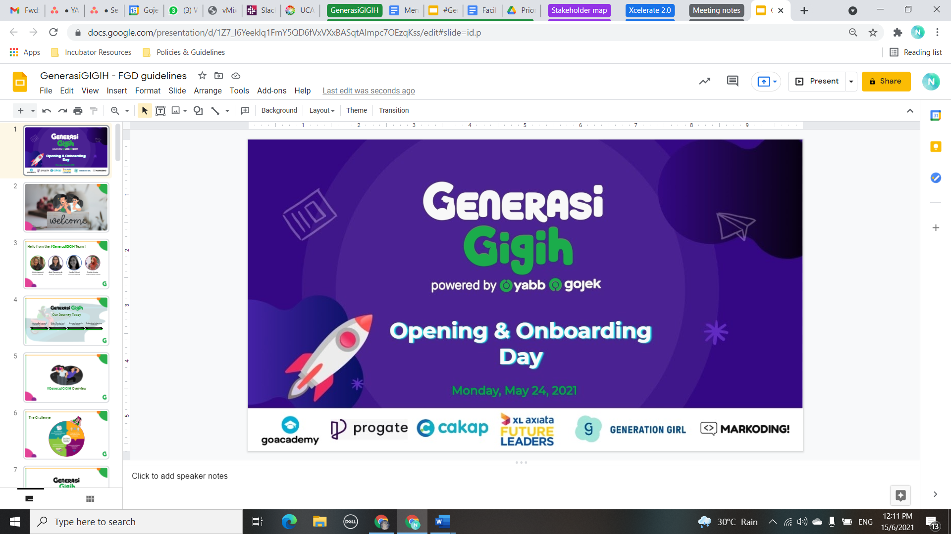
Government Actions as
a COVID-19 measure
In Indonesia with
different Festivals and Long–weekend
<Hendrik_GDA01203>
<Indonesia Covid-19 @kawalcovid19>
Opening & Onboarding
Day

Slide 2

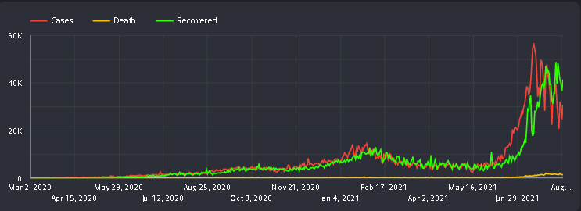


Covid-19 cases in Indonesia!

Slide 3


HELLO!

Slide 4
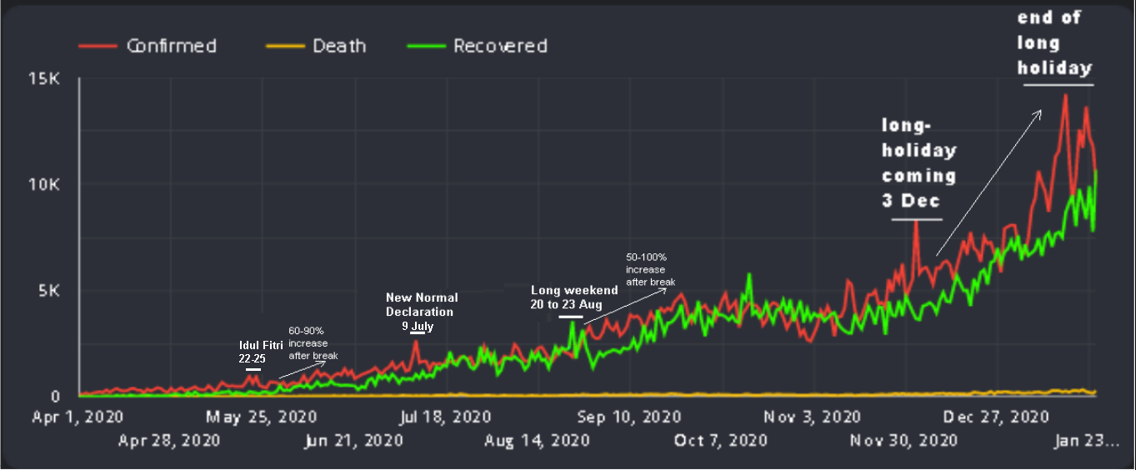

You look forward to it every year
to enjoy your food, life (like vacation)
with your friends or family.
What is that?
Holidays
(Graph in PSBB History)

Slide 5
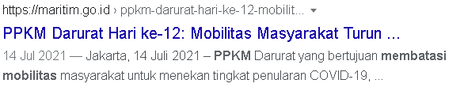
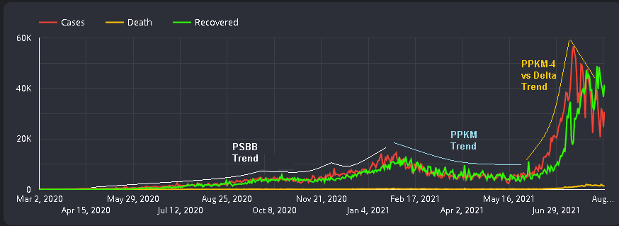
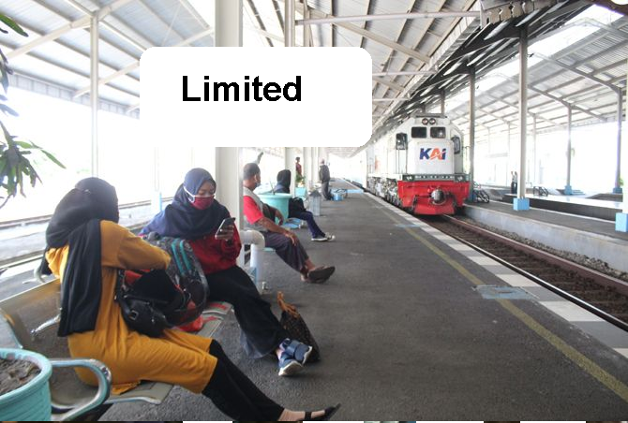
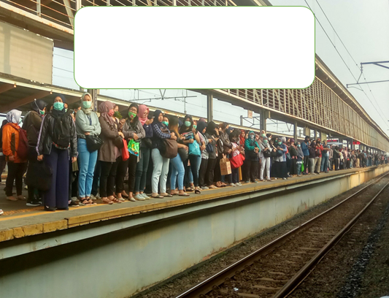

Better understanding

Slide 6


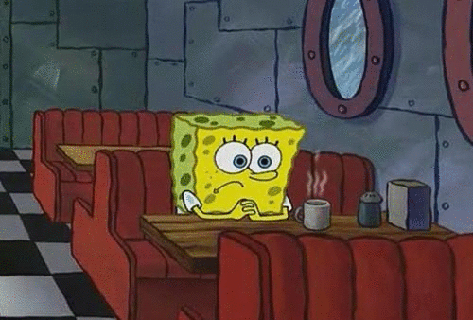


Slide 7



Learning Takeaways
What learning I got from working on this project?
“ the ability to see the big picture of the project and focus on particular details when needed deserves in my analyze”

Slide 8

Learning Takeaways
What other learning I feel throughout my journey in #GenerasiGIGIH?
Higher order thinking
Analysis report
Critical thinking

Slide 9

Thank you!

Slide 10

In this showcase we expect you to share not only the final result of your project but also the learning process you get from #GenerasiGIGIH
Things we want you to notice:
This is only a guideline, means you’re free to answer more questions to enrich your presentation, but remember that your showcase time is only 10 minutes.
Make a copy of this document before editing
The final showcase will be held in English
Feel free to add more things on this slide, picture, screenshot, anything!
Skip this README slide when you’re about to present your work
READ ME!

Slide 11
Explanation on your Project background
What is the problem you’re trying to solve through the projects?
How your project can solve the problem?
What’s scope of the projects?

Slide 12
Tech Use & Impact
What are the technology use in the project
How is this project gives impact or benefits to you and your community

Slide 13
Learning Takeaways
What learning do you get from working on this project?
What other learning do you feel throughout your journey in #GenerasiGIGIH?

Slide 14
Thank you!

